Slide 1
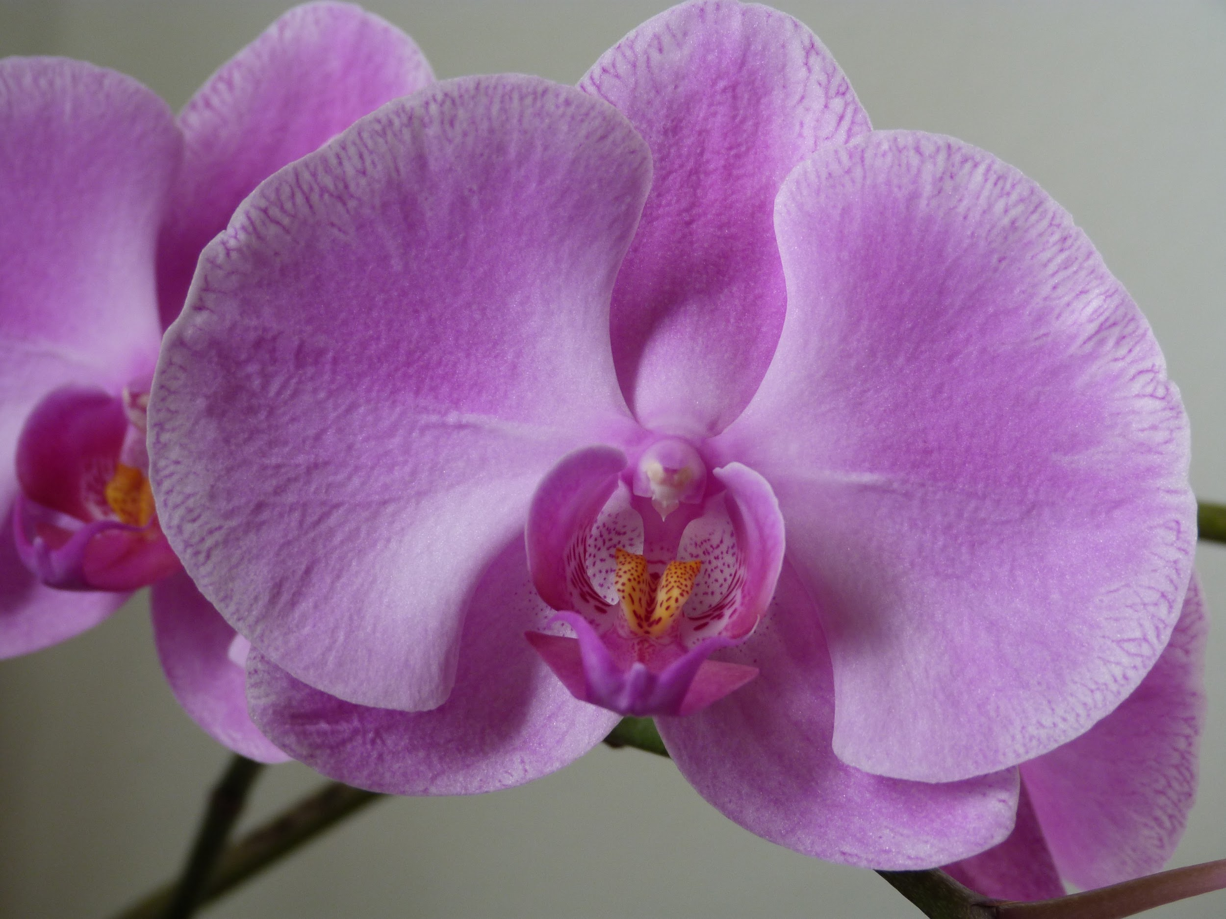
Scarlette Burgess-Wren, Teanda Chihwai, Brooke Dyson, Lavender Petty
Walker Mill Middle School 2018 - 2019 Ms.Epps/Park Mod 5

Slide 2
Question
What conditions are better for the survival of the Pine pink Orchid?

Slide 3
Research
Most orchids live in habitats with a minimal amount of light. Because of this, orchids and many other achlorophyllous depend on mycorrhizal fungi to give them the necessary nutrients they need. Without the nutrients orchids obtain by digesting the host fungi, their seed won't germinate and baby orchids will not grow. Orchid seeds only germinate when fungi are abundant, not merely present.Tropical orchids and fungi are also picky when associating with each other as well.

Slide 4
Research continued
Orchids are also bio-indicators for forests. If there is an abundance of orchids in a forest, then the forest is in a really good condition, especially the soil. This means that if all of a sudden the orchids are dying, that means that other species of organisms and species of plants that are in danger as well. Some orchids even will go dormant and stay underground in order to survive drought, deer or other dangers.

Slide 5
Hypothesis
We hypothesize that if the pine pink orchid is in different treatments, then then the fungi group would do the best because orchids need fungi to survive, so the groups without fungi will die.

Slide 6
Variables
IV: Type of treatment
DV: Growth of plant
Constants: Amount of water, amount of sunlight, Type of Orchid
Control Group: The control group
Experimental Group: The Fungi group, The Fertilizer group

Slide 7
Materials
1 Shelving Rack
1 Outlet Timer
4 Fluorescent Lights
3 horticulture trays
3 Insert Trays
3 Humidity Domes
3 Cut Insert Trays
Sterile Soil
Time Release Fertilizer

Slide 8
Materials
24 Horticulture Cups
30 Cellulose Plugs
24 Bletia purpurea seedlings
1 watering can
1 spray bottle
1 thermometer
Digital calipers
Rulers
Label tape (green, blue, and purple)
Gloves (green, blue, and purple)
Project description signs
Lab notebooks for data collection

Slide 9
Procedures
Label all pots and trays with the correct colored tape: Control=Green, Fertilizer=Blue, Fungi=Purple
Measure the corm of each plant only at the beginning of the experiment
Give the Control & Fertilizer groups a un-inoculated cellulose plug, which means it does not have fungi on it
Give the Fungi group an inoculated cellulose, which means it has Fungi on it
Place soil in the cup
Place 7 beads of fertilizer in the Fertilizer pots
Place the orchid plant into the pots with soil
Water the plants two times a week
Take measurements of the number of leaves, health of each plant, if the plant has any new shoots, and the length of the central leaf once every two weeks
Rotate the orchids once every two weeks

Slide 10
Procedures

Slide 11
Procedures
.

Slide 12
Procedures

Slide 13
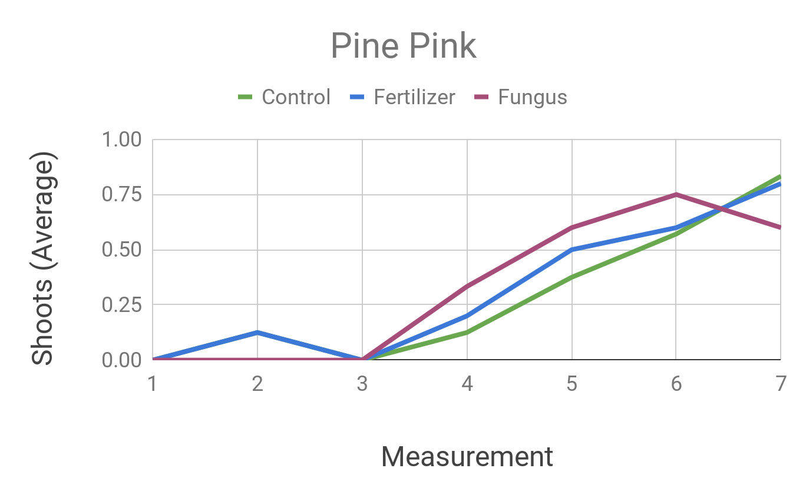
Graphs continued...

Slide 14
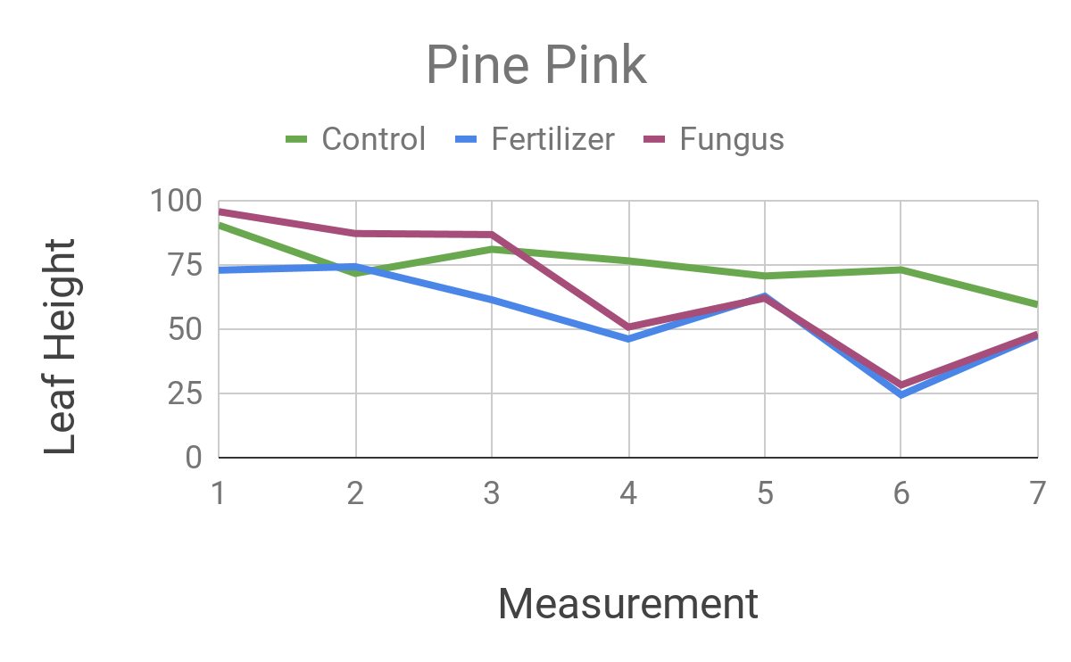
Graphs conutined...

Slide 15
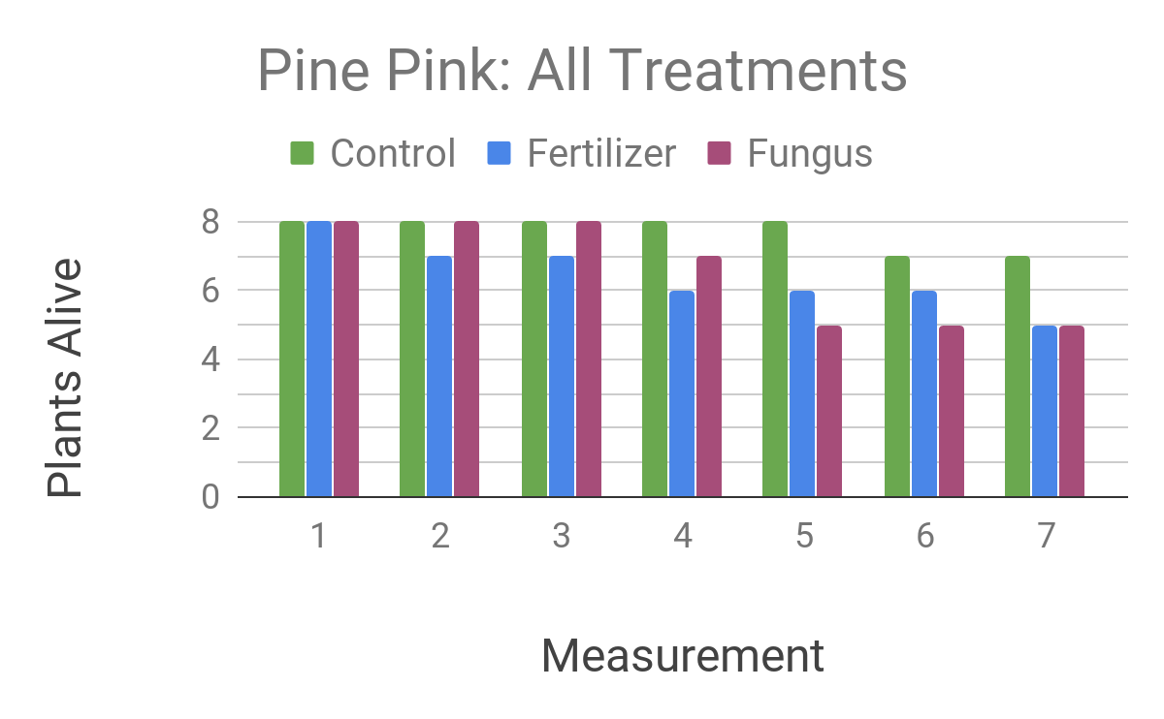
Graphs continued...

Slide 16
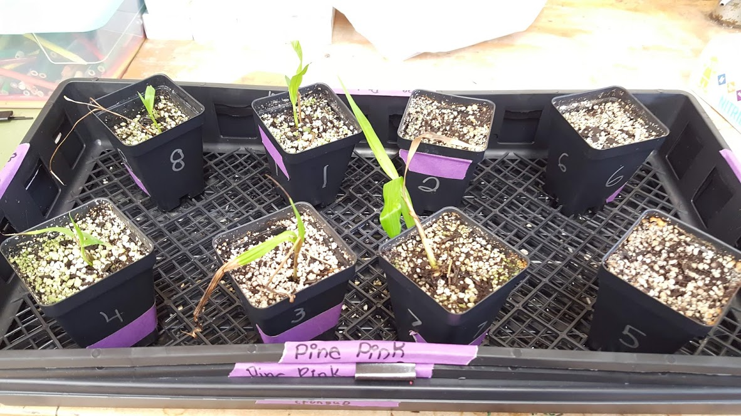
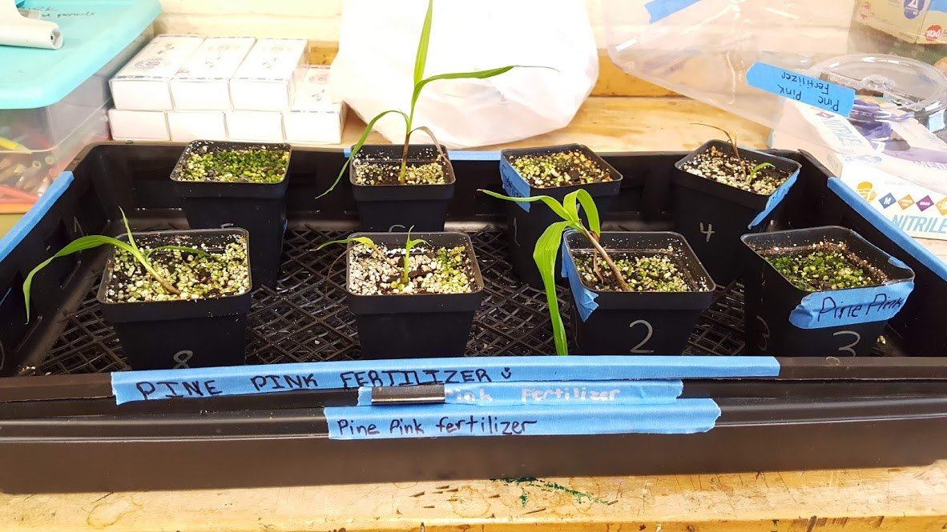
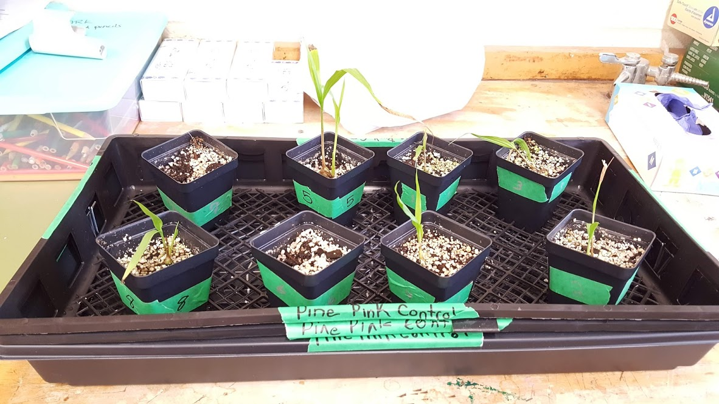
Pictures

Slide 17
Results
Our hypothesis was that the orchids in the fungi group would do the best out if all three. Our hypothesis was proven to be mostly incorrect because the control group ended up doing the best. The fertilizer had all 8 plants at the first measurement, then went down to 7 plants at the 2nd measuring. In each measurement the fungi and fertilizer went down on average 1 to 2 plants. They ended up evening out the amount left over for the last measuring. The control group only lost 1 plant the entire experiment, which was on the 6th measurement. In the final measurement 7 control ,5 fertilizer and 5 fungi were alive for the pine pink orchids.
Early on in the experiment, the majority of the three treatments were starting to grow new shoots. It started with the fertilizer treatments, and then the fungi shortly after. At the third measurement, all the treatments had at least one plant with an extra shoot.
At the first measurement the fungus and control groups were at 100mm and the fertilizer wasat 75 mm. Then all the treatments declined except for the fertilizer which went up slightly at the second measurement..It went down at the third measurement to around 50 millimeters, giving the control treatment the tallest central leaf.In the seventh measurement the control, fertilizer and fungus met up at around 50 mm for the leaf height.

Slide 18
Conclusion
We hypothesized that if the pine pink orchids were in the fungi treatment they would do the best out of the three. We believe that the data shows that our hypothesis was primarily wrong. One reason for this is the orchids with the fungi treatment died off more rapidly than the other two treatments. Although in the end, both the fungi and fertilizer treatments had the same amount of plants alive which was 5 but the control group had 7 plants alive.
However, the number of new shoots were partially in favor of our hypothesis because the number of new shoots were increasing by the 6th measurement for the fungi treatment.
One interesting thing we learned during the experiment was that for a few plants when they gained a new shoot the older ones started to die. We have a theory that this is because a majority of the plants nutrients went to the new shoot, giving the older one less resources to survive. In conclusion with the evidence provided, our hypothesis was wrong.

Slide 19
Recommendations
Although we enjoyed the experiment, there are things we would like to change in the experiment. We would change the number of fertilizer pellets to 3 to 4 instead of 7 pellets.. We think that the fertilizer plants would be more successful with less pellets since the control group did better than the fertilizer with no pellets.

