Slide 1
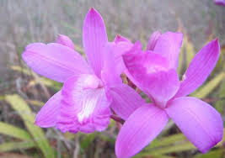
Gotta Grow!!!
By : Mujib Ogunade, Marcus Bryant, Oluwatobiloba Odukoya, Bafoday Dainkeh
Walker Mill Middle School 2018 - 2019
Teacher: Ms. Park Mod: 5
Due: April 12, 2019

Slide 2
Question
What is the best condition/treatment for a Pine Pink orchid to live off of; fungus, fertilizer or no treatment at all?
?

Slide 3
Research : What are Pine Pink Orchids?
Bletia purpurea, commonly called Pine Pink, is distributed mainly in Florida's Everglades and Fakahatchee Swamp and occurs in various parts of the West Indies, Central America, and northern South America. This orchid may produce both cleistogamous and chasmogamous flowers on the same plant, although this condition can vary from year to year. There are usually 3-5 light green leaves with 3-80 pink to purple or white flowers with a gold crest on the lip. In the Everglades, this orchid, flowers from December to March and grows in open habitats where it prefers to wedge its bulb into rocky crevices. In the Fakahatchee Swamp, flowering occurs from April to May and they grow in the shade, usually on stumps, floating logs, and at the base of cypress trees just above the water level. Bletia purpurea is considered secure globally because of its widespread distribution, although it is threatened in Florida.

Slide 4
Research : How do Pine Pink Orchids live?
They also don’t have rostellum (a flap of tissue), and are self-pollinating. Most are in Florida. Pine Pink orchids are also terrestrial, meaning that they grow in the ground, or on the ground. Fungi helps orchids by absorbing water and nutrients, in exchange, they get carbohydrates. However the orchid is the only one who benefits from this. Especially the orchid is the parasite, sucking from the fungi for nutrients.

Slide 5
Hypothesis
We hypothesize that the Fungus group would do the best in staying alive, leaf height, the amount of shoots, and the amount of new leaves out of the three treatments.

Slide 6
Variables
1) IV- Treatment for Pine Pink Orchids
2) DV- The overall quality of the Pine Pink Orchid over time
3) Constants- Same type of water, same pots, same type of plants, watered the same days, same amount of light, in the same environment
4) Control Group- Control( No treatment)
5) Experimental Group- Fungus, Fertilizer

Slide 7
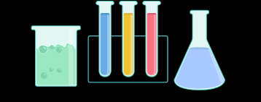
● 1 shelving rack
● 1 outlet timer
● 4 fluorescent lights
● 3 horticulture trays
● 3 insert trays
● 3 cut insert trays
● 3 humidity domes
● Sterile soil
● Time release fertilizer
● 24 horticulture cups
● 30 cellulose plugs
● 24 Bletia purpurea seedlings
● 1 watering can
● 1 spray bottle
● 1 thermometer
● Digital calipers
● Rulers
● Label tape (green, blue, and purple)
● Gloves (green, blue, and purple)
● Project description signs
● Lab notebooks for data collection
Materials

Slide 8
Procedures
1. Place green label tape on one tray and one dome, use a black Sharpie marker to write Pine Pink Orchid – Control Treatment on the green tape.
2. Repeat Step 1 using the remaining trays/domes and the blue and purple tape
a. Label the tray and dome with blue tape with the type of orchid and Fertilizer Treatment
b. Label the tray and dome with purple tape with the type of orchid and Fungus Treatment

Slide 9
3. Divide each tray into 8 equal parts, include the mesh tray with holes where the cups will be placed. Draw lines using a silver Sharpie to indicate each of the eight sections. Label each section with a number from 1-8. Repeat for each treatment.
4. Set up the trays
a. Attach a binder clip to each side of the uncut mesh insert tray
b. Place the uncut mesh insert tray inside the solid, black horticultural tray

Slide 10
5. Use a silver Sharpie marker to label six sets of horticulture cups from 1-8
6. Each set of cups numbered 1-8 represents a treatment. Use label tape to identify which treatment each cup belongs to. When adding the label tape, be careful not to cover the cup number.
a. Label the sets of cups as follows:
i. Using green tape – “Control Treatment – Pine Pink Orchid”
ii. Using blue tape – “Fertilizer Treatment – Pine Pink Orchid”
iii. Using purple tape – “Fungus Treatment – Pine Pink Orchid”

Slide 11
7. Deflask the orchids. Students should wear gloves when doing this. In order to avoid cross-contamination, students should change gloves if they change the treatment that they are preparing.
a. Use a chopstick to gently separate the seedling from the flask. Be careful not to damage the roots.
b. Gently rinse the agar off the roots. This can be done at a sink or in a basin of clean water over a colander.
c. Place the seedling roots in water while the cups are being prepared. Be sure to keep the roots wet so that the seedlings don’t begin to wilt.

Slide 12
8. Measure the corm (ball-like root structure) and plant the orchids. Students should wear gloves, and should change gloves if they switch the treatment they are preparing.
a. Place a cellulose plug in the bottom of the cup as close to the center of the
cup as possible
i. For Control Treatment (green) cups and for Fertilizer Treatment (blue) cups, add an uninoculated cellulose plug
ii. For Fungus Treatment cups, add one inoculated cellulose plug
b. Fill each horticulture cup almost to the top with soil mixture. Pack the soil
down so that about half an inch of space is left at the top
c. Use calipers to measure the width of the corm (the bulbous part at the top
of the root that looks kind of like an onion). Be very gentle when using the
calipers so that you don’t damage the plant
i. Record the corm width and the plant number in a lab notebook. This should be done on a sheet of paper and added into the Google Form when other measurements are made
d. Place the seedling in a cup with soil
i. Fill the rest of the cup with soil and gently pat down around the
plant. The top of the corm should be visible above the soil
ii. For Fertilizer Treatment ONLY, add 7 fertilizer pellets to the top of
the soil when finished planting

Slide 13
9. Collect baseline data for each plant
i. Use a lab notebook to record the health of
each plant (alive or dead), the number of leaves, and the length of the central leaf (see the next section for details on making this measurement). Be sure to include the root measurements you made earlier in the Google Form.
b. Please take pictures of the data sheets or notebooks where baseline data is recorded and email them to SERCOutreach@si.edu. This helps staff at SERC ensure that any errors in baseline data entry are corrected.

Slide 14
10. Water the plants using the watering can. Each plant should receive enough water so that the soil is moist all the way through to the bottom of the cup. Try to give each plant the same amount of water. Repeat for each treatment.

Slide 15
11. Assign a randomized location to each plant within the horticultural tray.
a. For each treatment
i. Generate a sequence of 8 random integers from 1-8 for each treatment using www.random.org/sequences (scroll down the page to the part that says “sequence generator”)
ii. Use those numbers to determine the location of each plant within its horticultural tray. For example, imagine that you are working with Pine Pink Orchid Fungus Treatment plants, and you have plant numbers 1-8. If your random number list is 4,5,1,7,2,6,8,3, then plant 1 goes to position 4, plant 2 goes to position 5, and so on.
iii. Place the plants in the number holes in the cut mesh insert tray
iv. Repeat for each treatment. Be sure that the plants are going into the correct treatment they belong with (for example, Pine Pink
Orchid Control plants only go in the tray labeled Pine Pink Orchid Control)
v. When all 8 plants are in the cut mesh insert tray, place the cut tray (and plants) on top of the binder clips attached to the uncut insert tray
vi. Plants should be placed in the appropriate spot in the cut insert tray and then placed on top of the binder clips attached to the uncut insert tray (which should be inside the solid horticultural tray). (See photo on next page.) This keeps the cups from falling over and gives room for the water to drain away from the plants.

Slide 16
12. Place 2 trays on each shelf. The plants should be approximately centered under the lights.
a. It doesn’t matter which treatment is placed in which location on the shelf. All of the trays will be rotated every other week.
13. Place a humidity dome over each tray. Open the valves about half way
14. After one week, open the valve on each humidity dome all the way

Slide 17
Data
 | Pine Pink
Measurement | Control | Fertilizer | Fungus
1 | 8 | 8 | 8
2 | 8 | 7 | 8
3 | 8 | 7 | 8
4 | 8 | 6 | 7
5 | 8 | 6 | 5
6 | 7 | 6 | 5
7 | 7 | 5 | 5

Slide 18
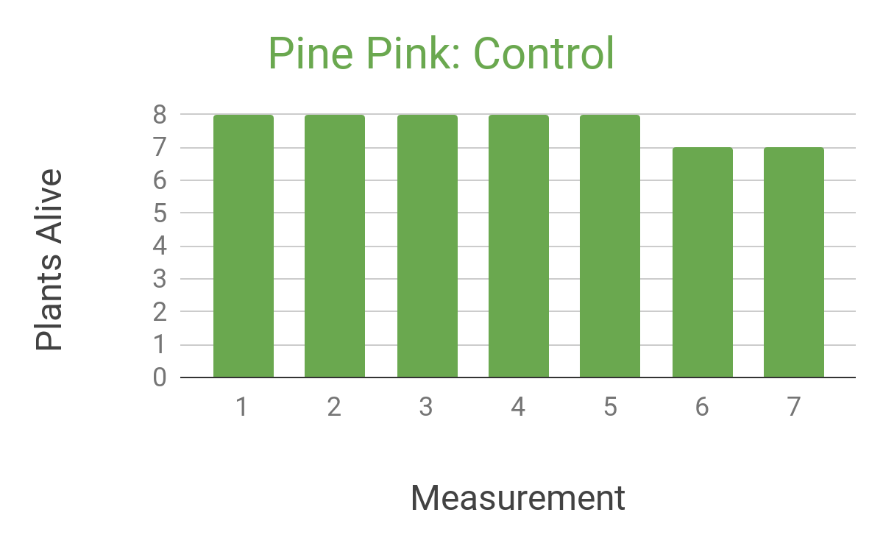
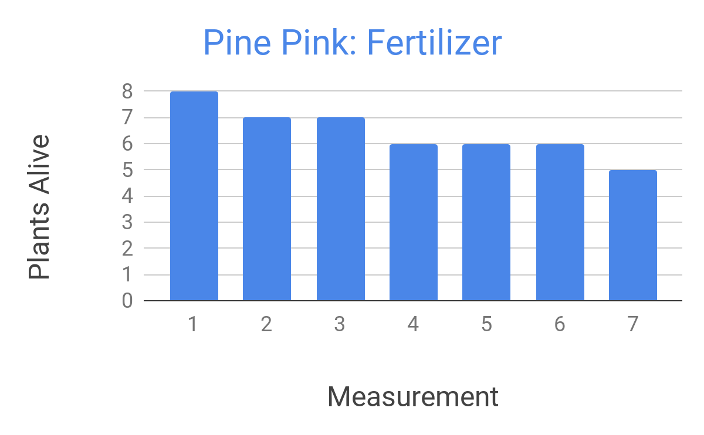
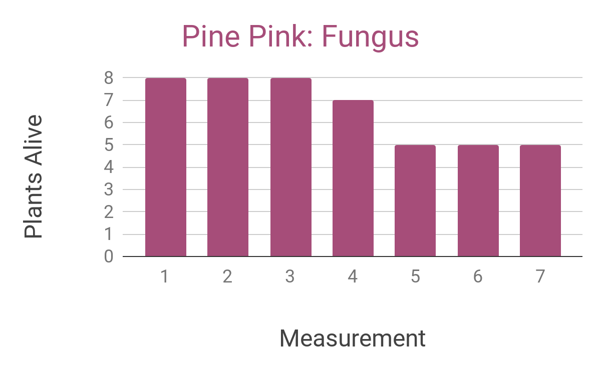
Graphs

Slide 19
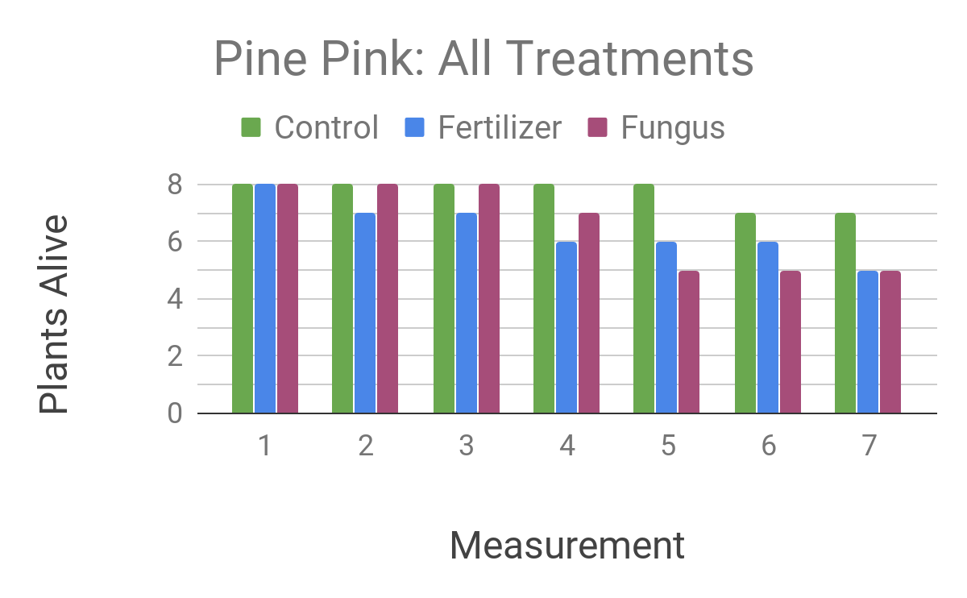
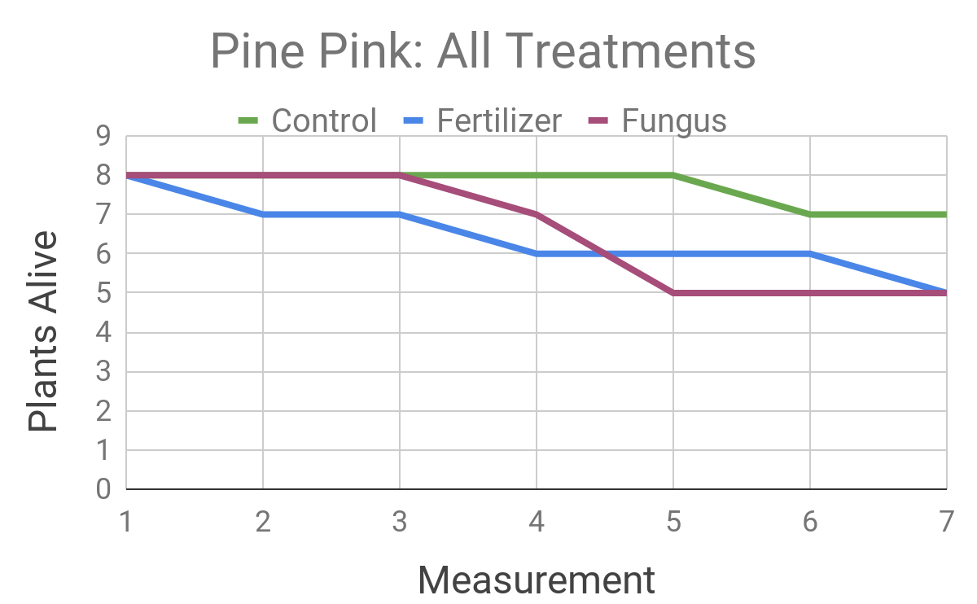
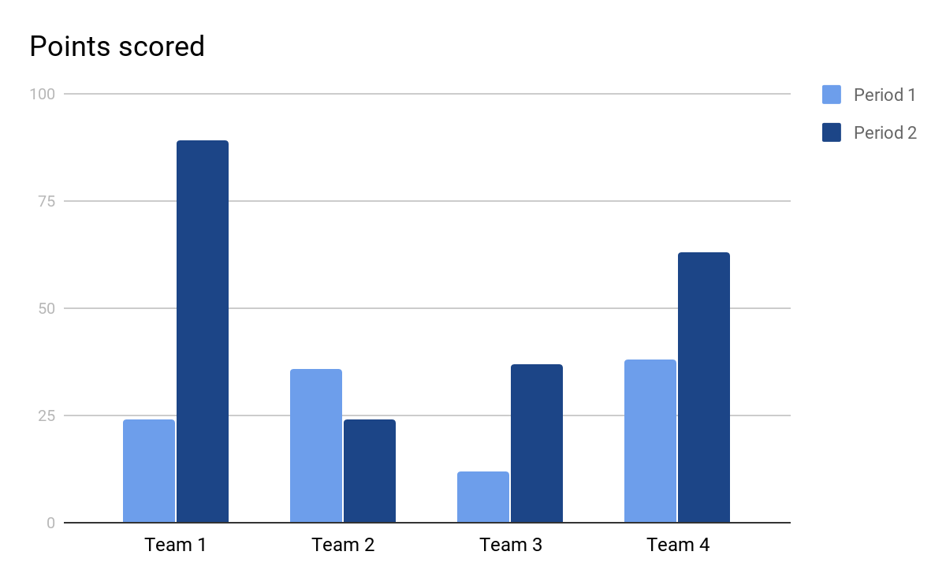
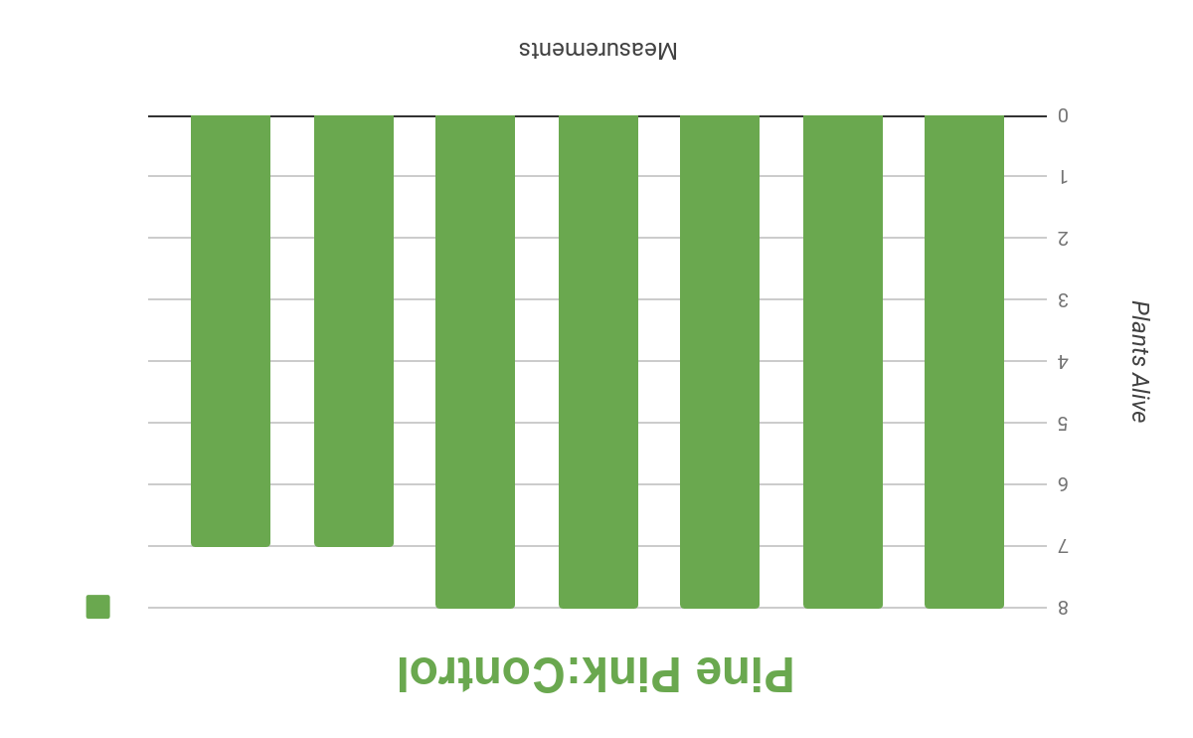
Graphs

Slide 20
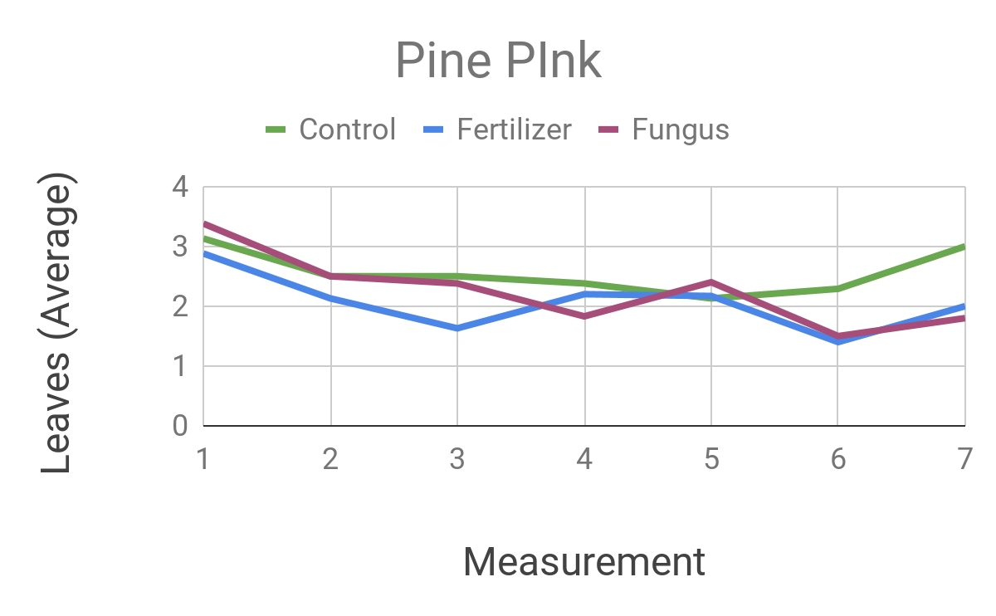
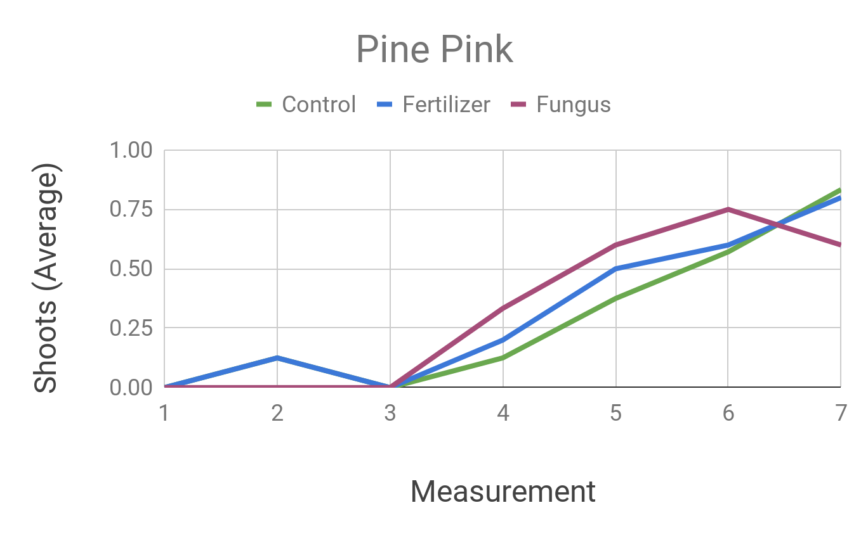
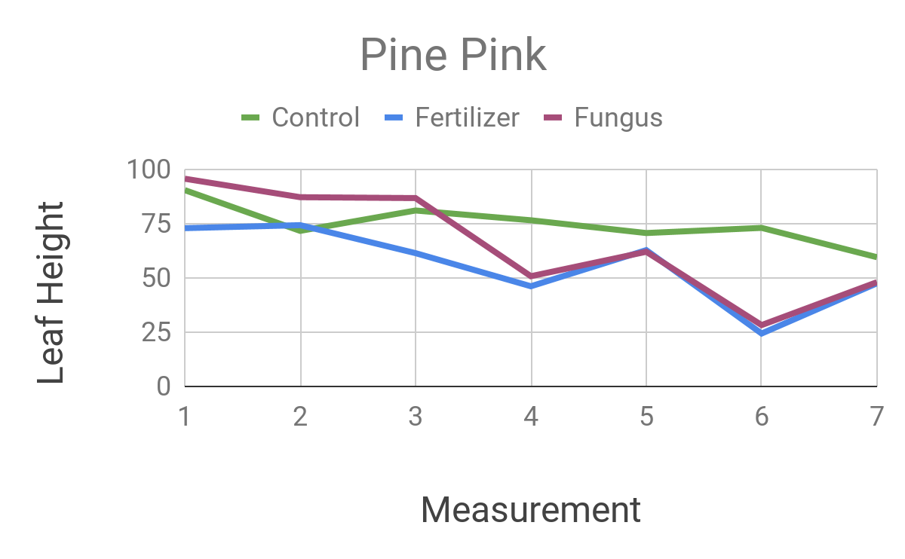
Graphs

Slide 21
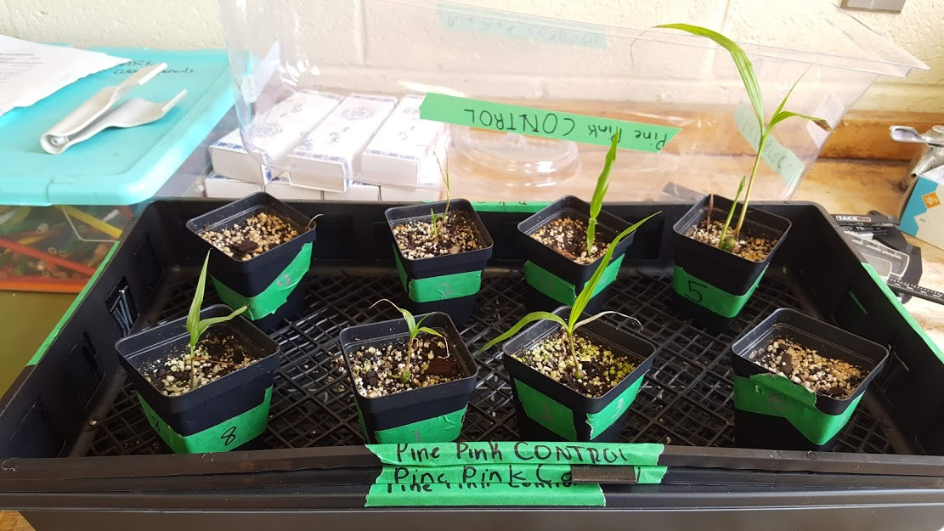
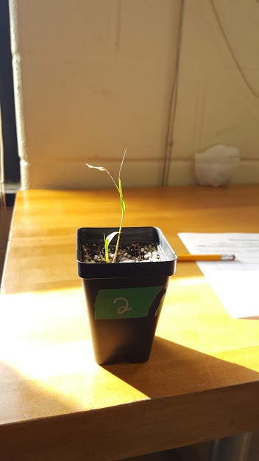
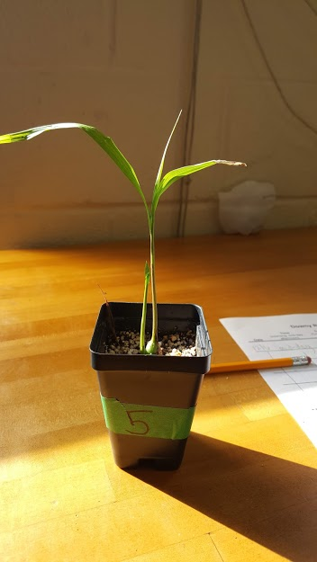
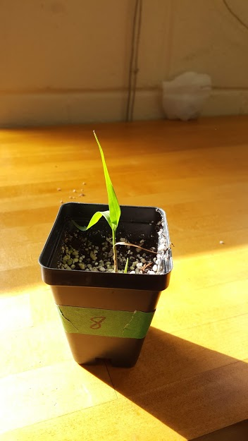
Pictures
December 6th

Slide 22
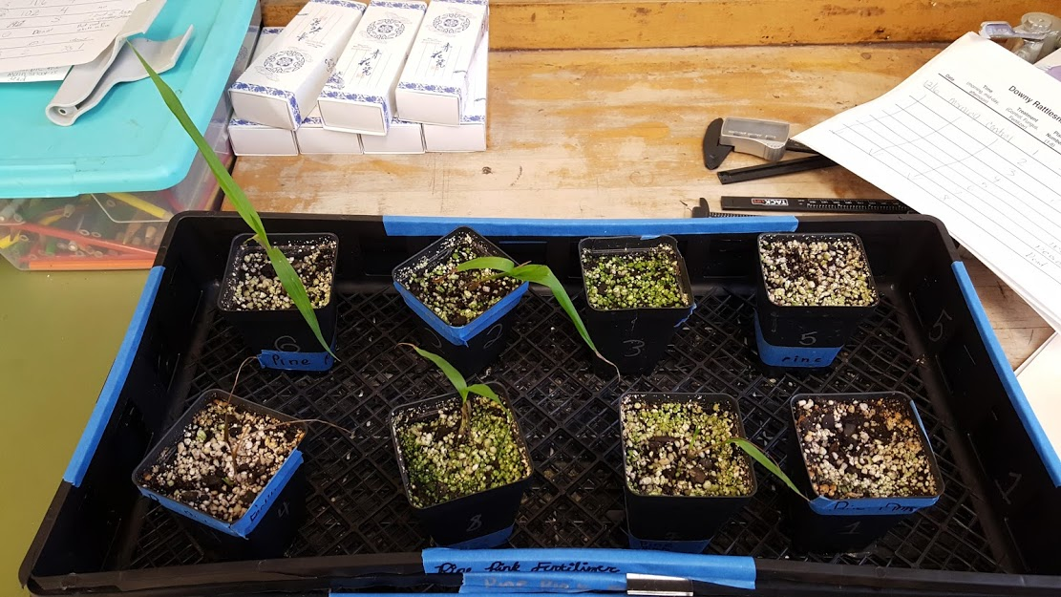
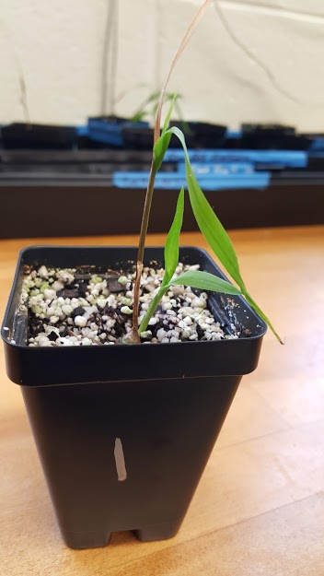
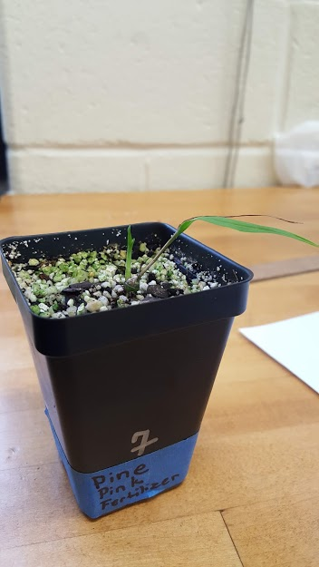
Pictures
December 6th

Slide 23
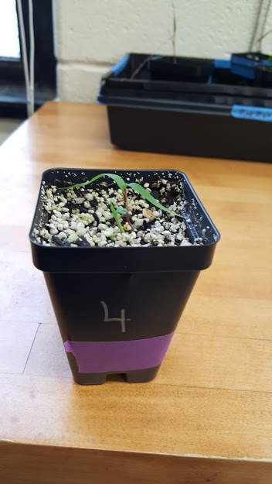
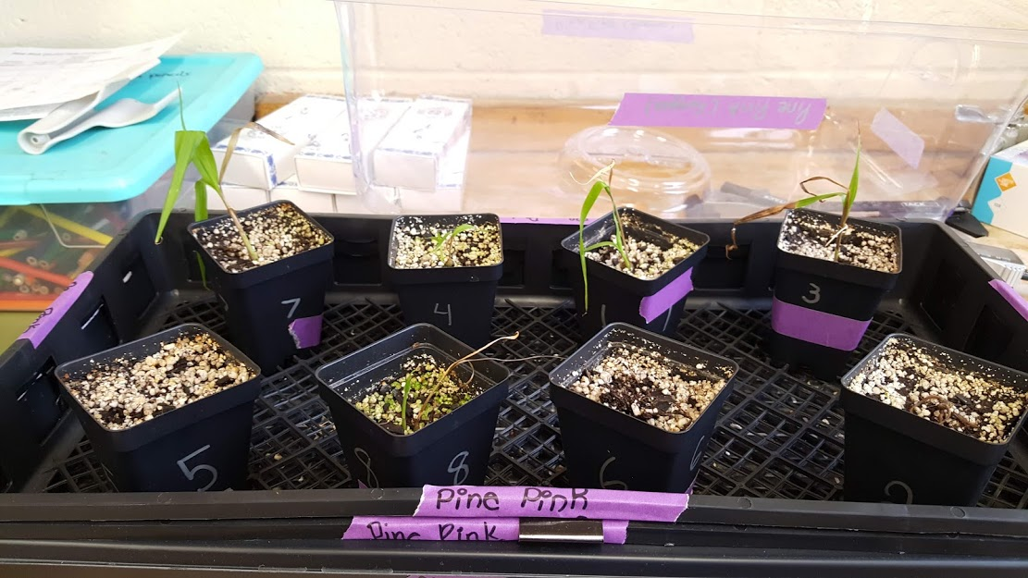
Pictures
December 6th

Slide 24
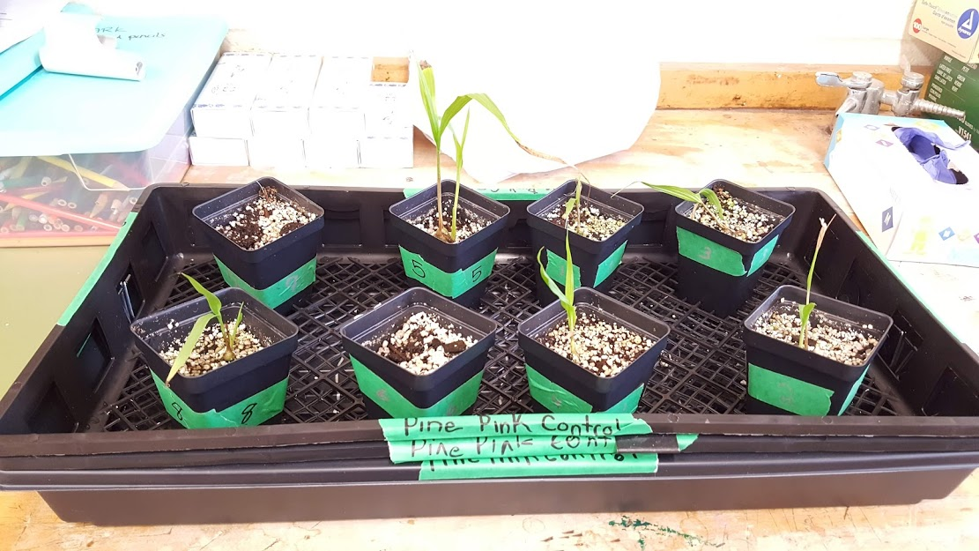
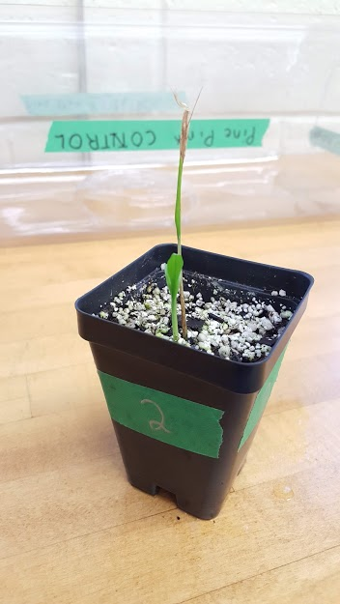
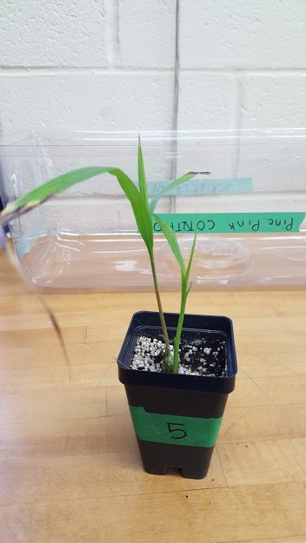
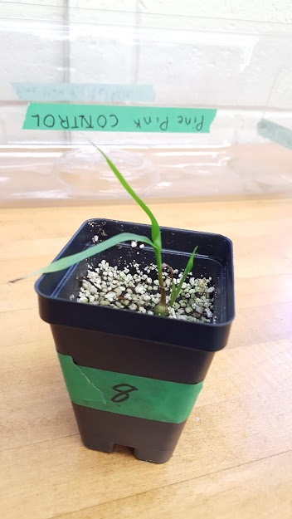
Pictures
December 21st

Slide 25
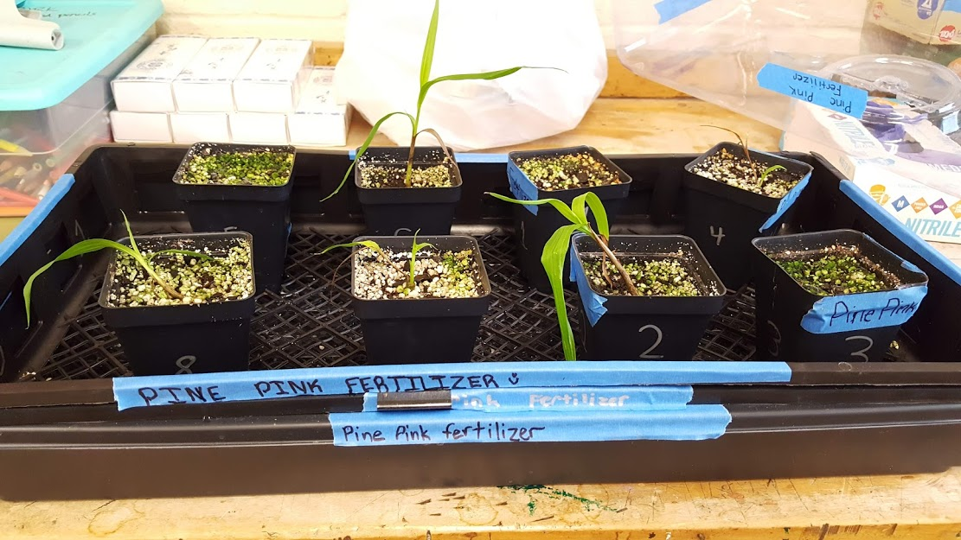
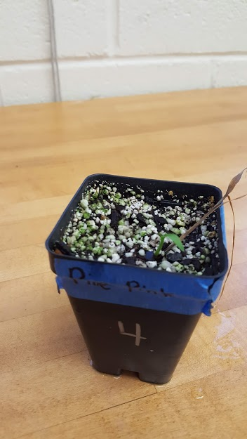
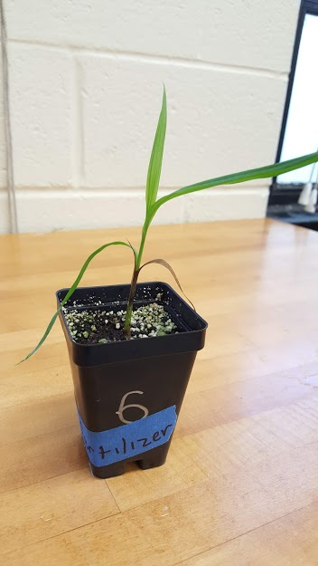
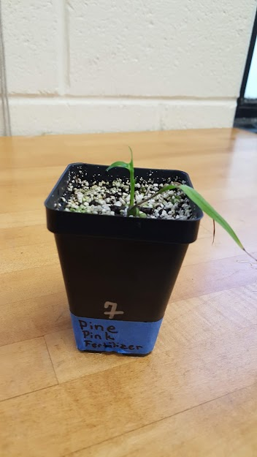
Pictures
December 21st

Slide 26
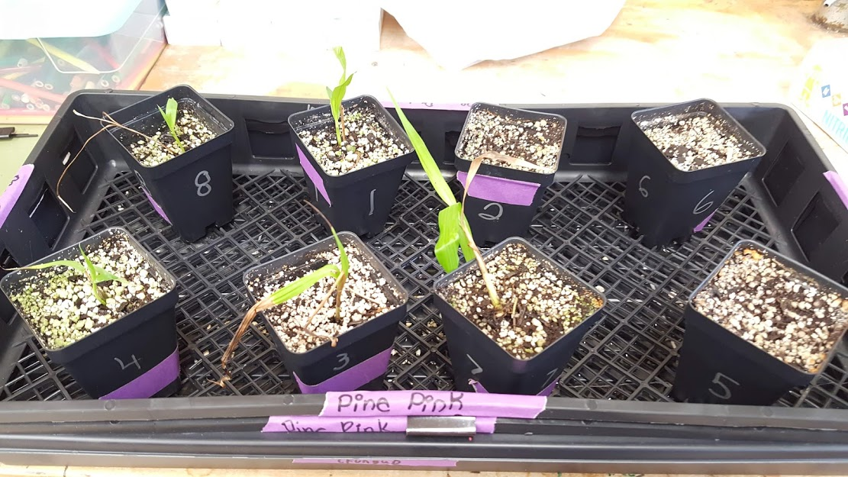
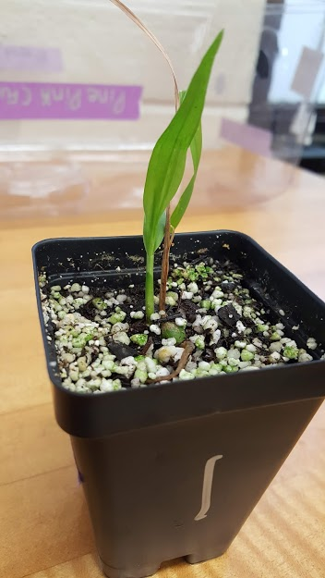
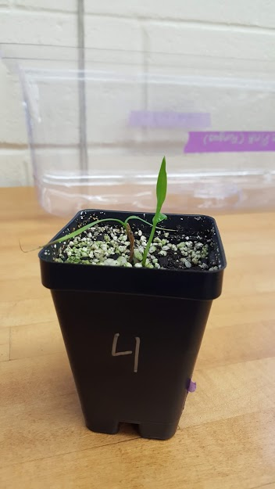
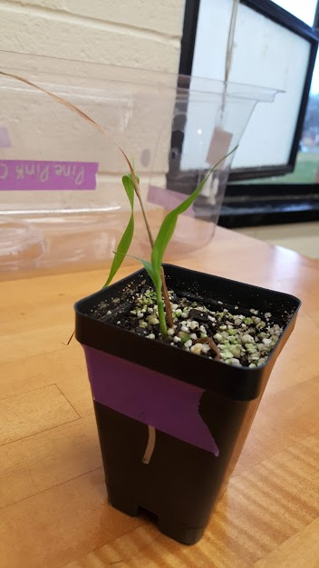
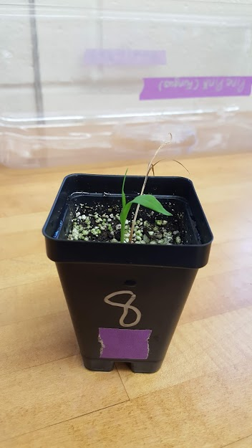
Pictures
December 21st

Slide 27
Results
The experiment has shown that the control group has done the best in showing what condition pine pink orchids grow in the best. At the end of the experiment, the control group kept a total of ⅞ orchids alive; the fertilizer group kept a total of ⅝ orchids alive; and the fungi group kept a total of ⅝ orchids alive.
The control group had an average of 3 new leaves; the fertilizer group had an average of 2 new leaves; and the fungi group had an average of 2 new leaves.
The control group had an average leaf height of 62mm; the fertilizer group had an average leaf height of 47mm; and the fungi group had an average leaf height of 49mm. The control group had an average of 0.85 new shoots; the fertilizer group had an average of 0.8 new shoots; and the fungi group had an average of 0.6 new shoots. The control group had the most plants alive, more leaves, tallest leaves, and more new shoots! So, all together the control group did the best between the 3 treatments.

Slide 28
Conclusion
We hypothesized that the Fungus group would do the best in staying alive, leaf height, the amount of shoots, and the amount of new leaves out of the three treatments. Our hypothesis was incorrect. The Control group did the best overall and kept 7 plants alive, 3 new leaves, an average leaf height of 62mm, and had an average of 0.85 new shoots at the end of the experiment! So, our hypothesis was not supported since the control group did the best. Based on the fact that the control group succeeded the best in all of this data, they did the best. Knowing this information could help the Orchids come back and be a normal species instead of an endangered one like they are now.

